Slide 1

EXTREME BEAMS AT THE SRF PHOTOINJECTOR
Increasing the time resolution of UED experiments
Benat Alberdi, Ji-Gwang Hwang, Axel Neumann and Thorsten Kamps
September 09, 2022 | Helmholtz-Zentrum Berlin
Member of the Helmholtz Association

Slide 2
Outlook
Completed tasks
Beam-line modifications for enabling extreme beam operation of the SRF Photoinjector.
Optimization of transverse parameter space for static diffraction experiment.
Longitudinal phase-space manipulation scheme using the booster section.
Development of ToF jitter model and time resolution optimization.
Simulations for beam spot size retrieval from interferometric pattern.
Task in progress
Target sample production and testing for static diffraction experiment.
Arrival time monitor cavity design.
Machine learning model for the SRF Photoinjector.
Study and implement emittance minimization alternatives: The Spatial Light Modulator
To do!!
Measurement campaign: beam characteristics and static diffraction experiment.

Slide 3
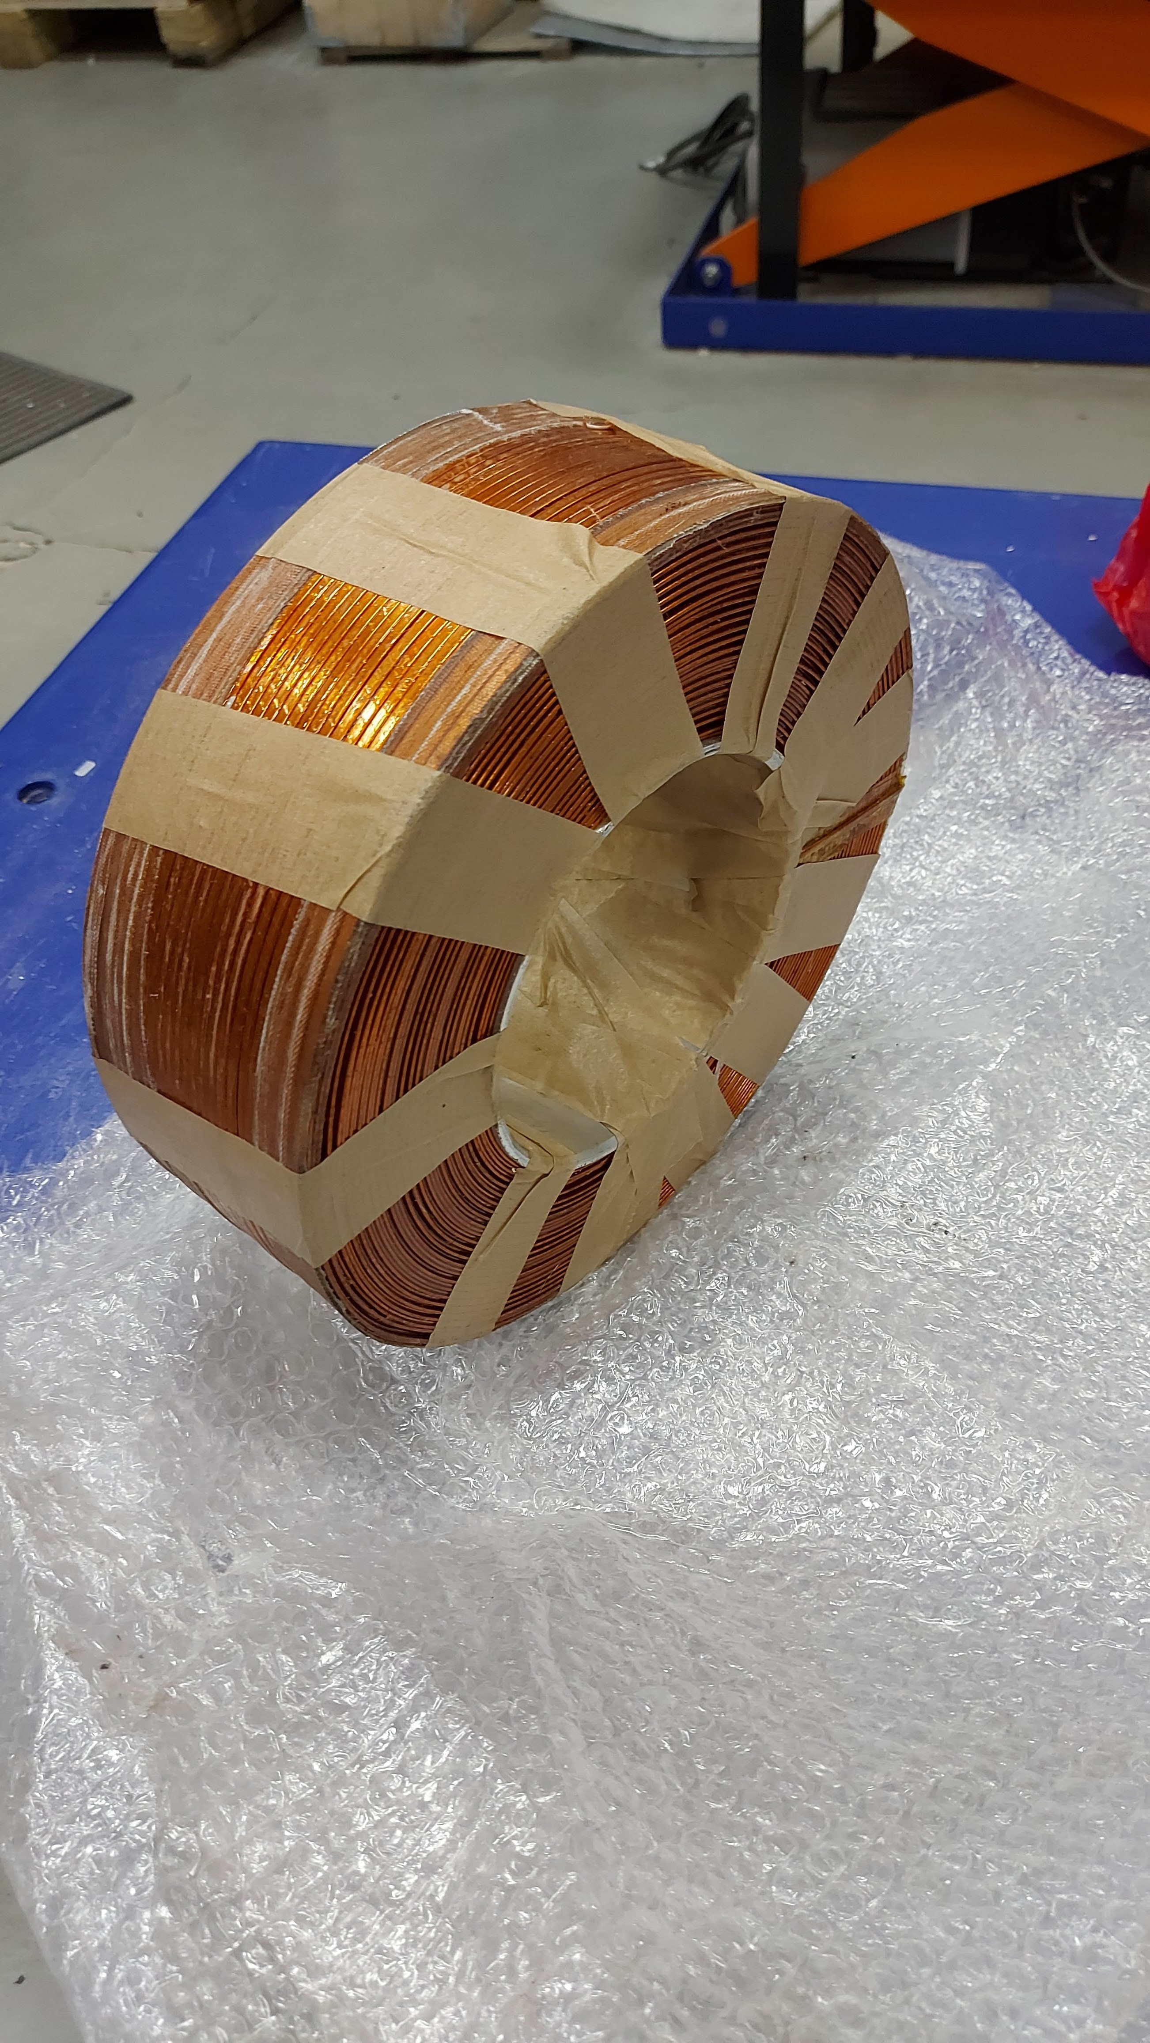
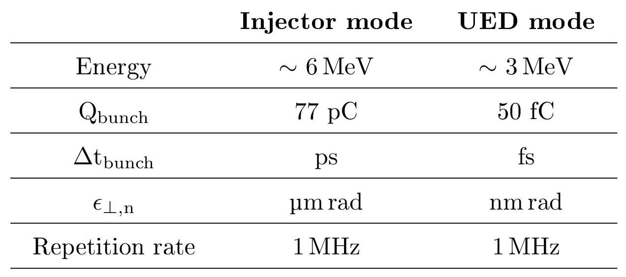
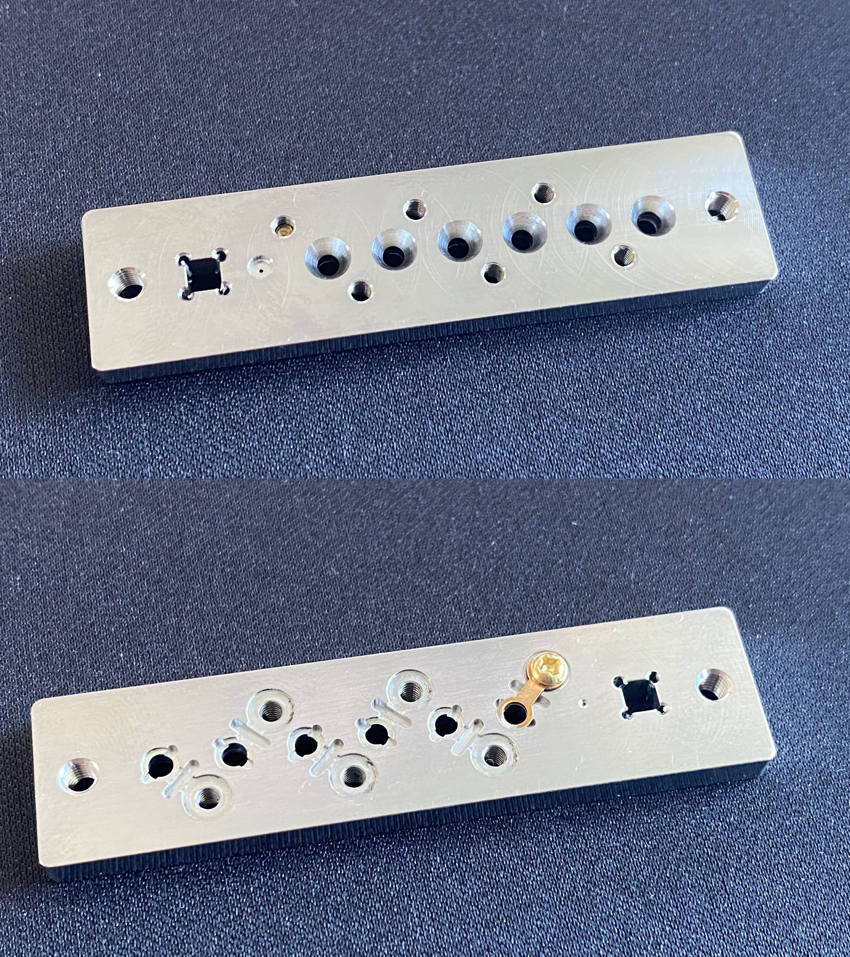
The SRF Photoinjector
Aperture
Solenoid
Target station
Solenoid
Aperture
TCAV and diagnostics
Target station
Booster section
Gun and solenoid

Slide 4
Ultrafast electron diffraction

Slide 5
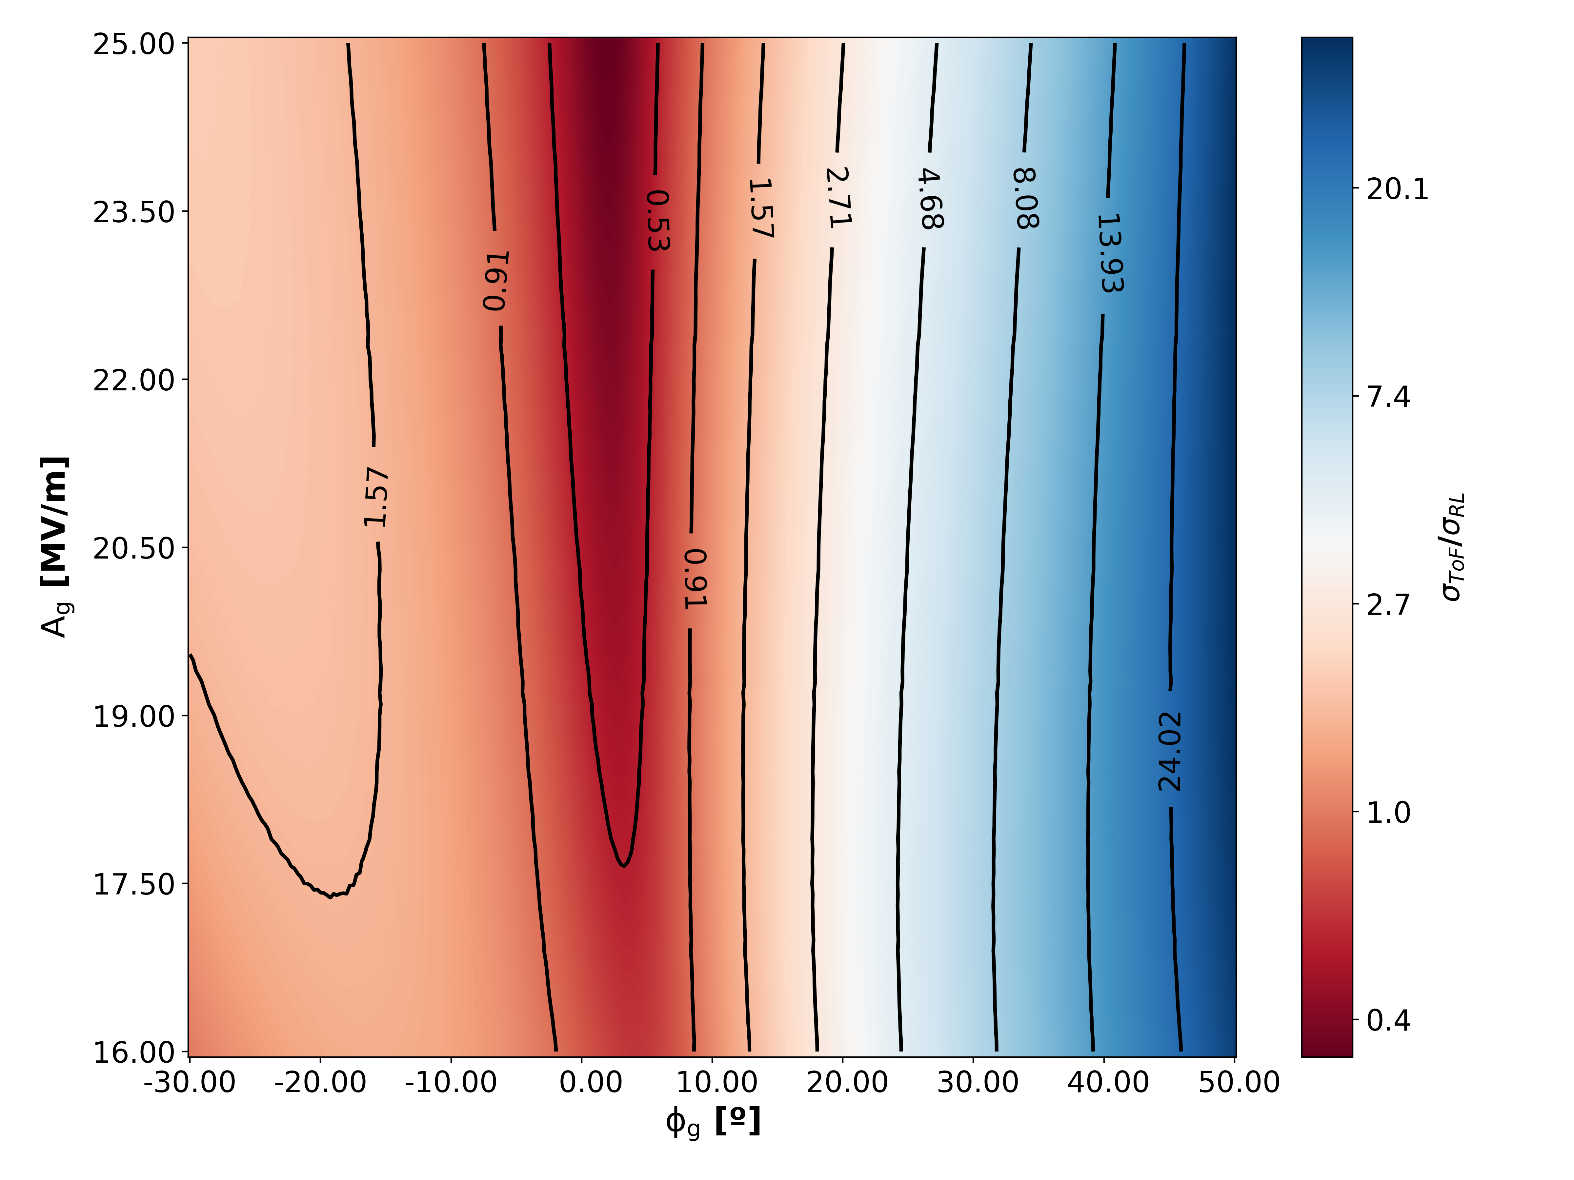
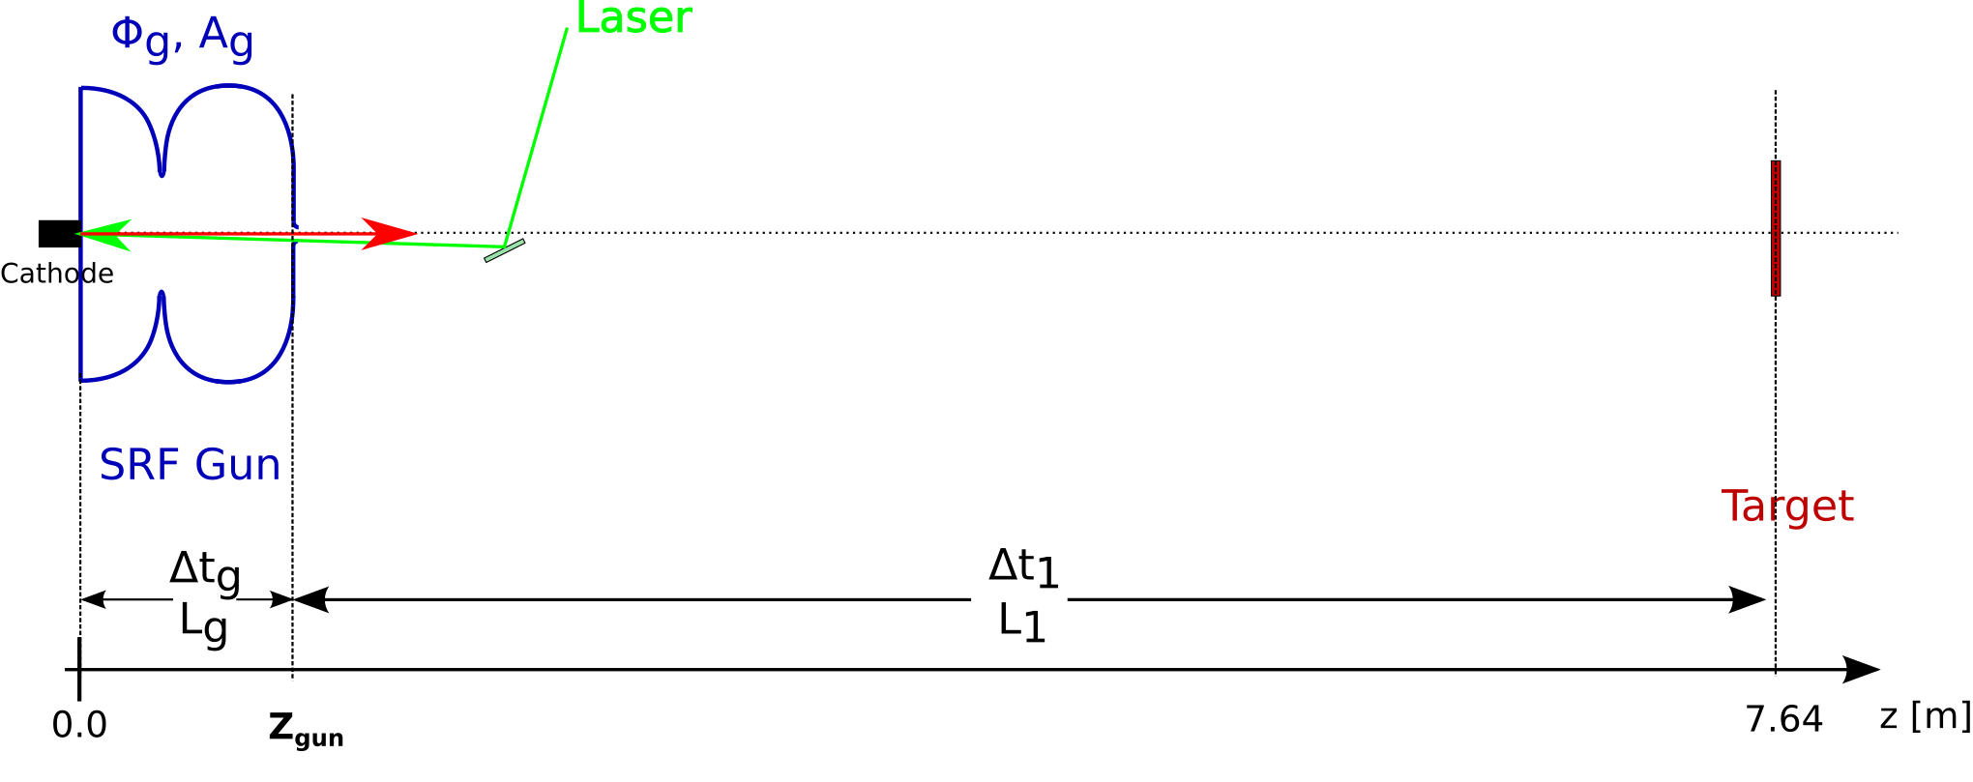
Time of flight jitter

Slide 6
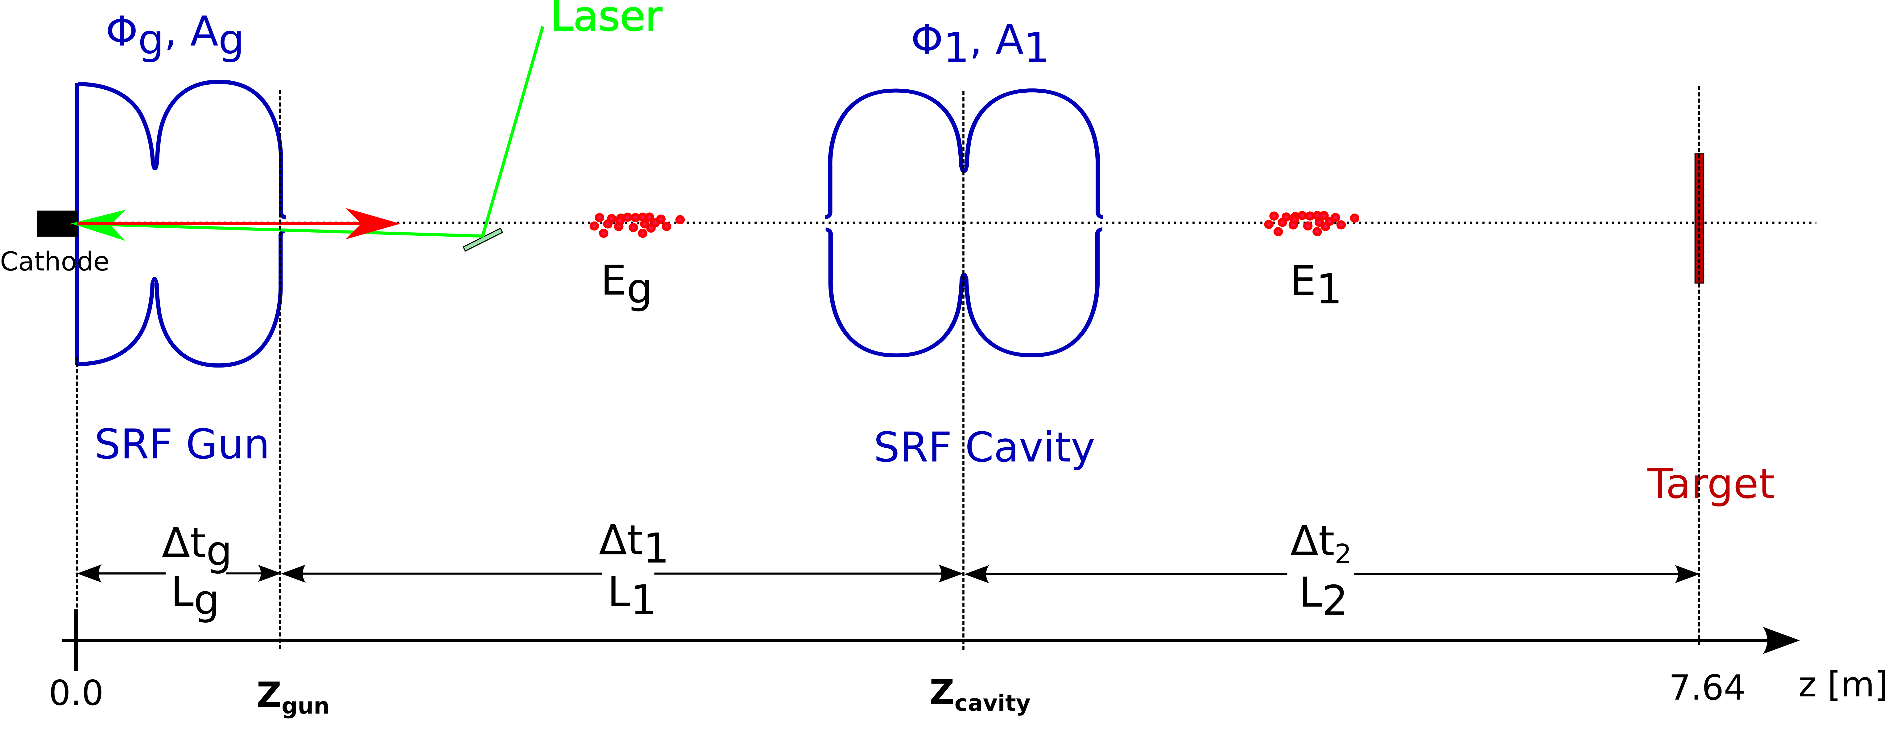
Time of flight jitter – multiple cavities

Slide 7
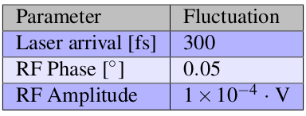
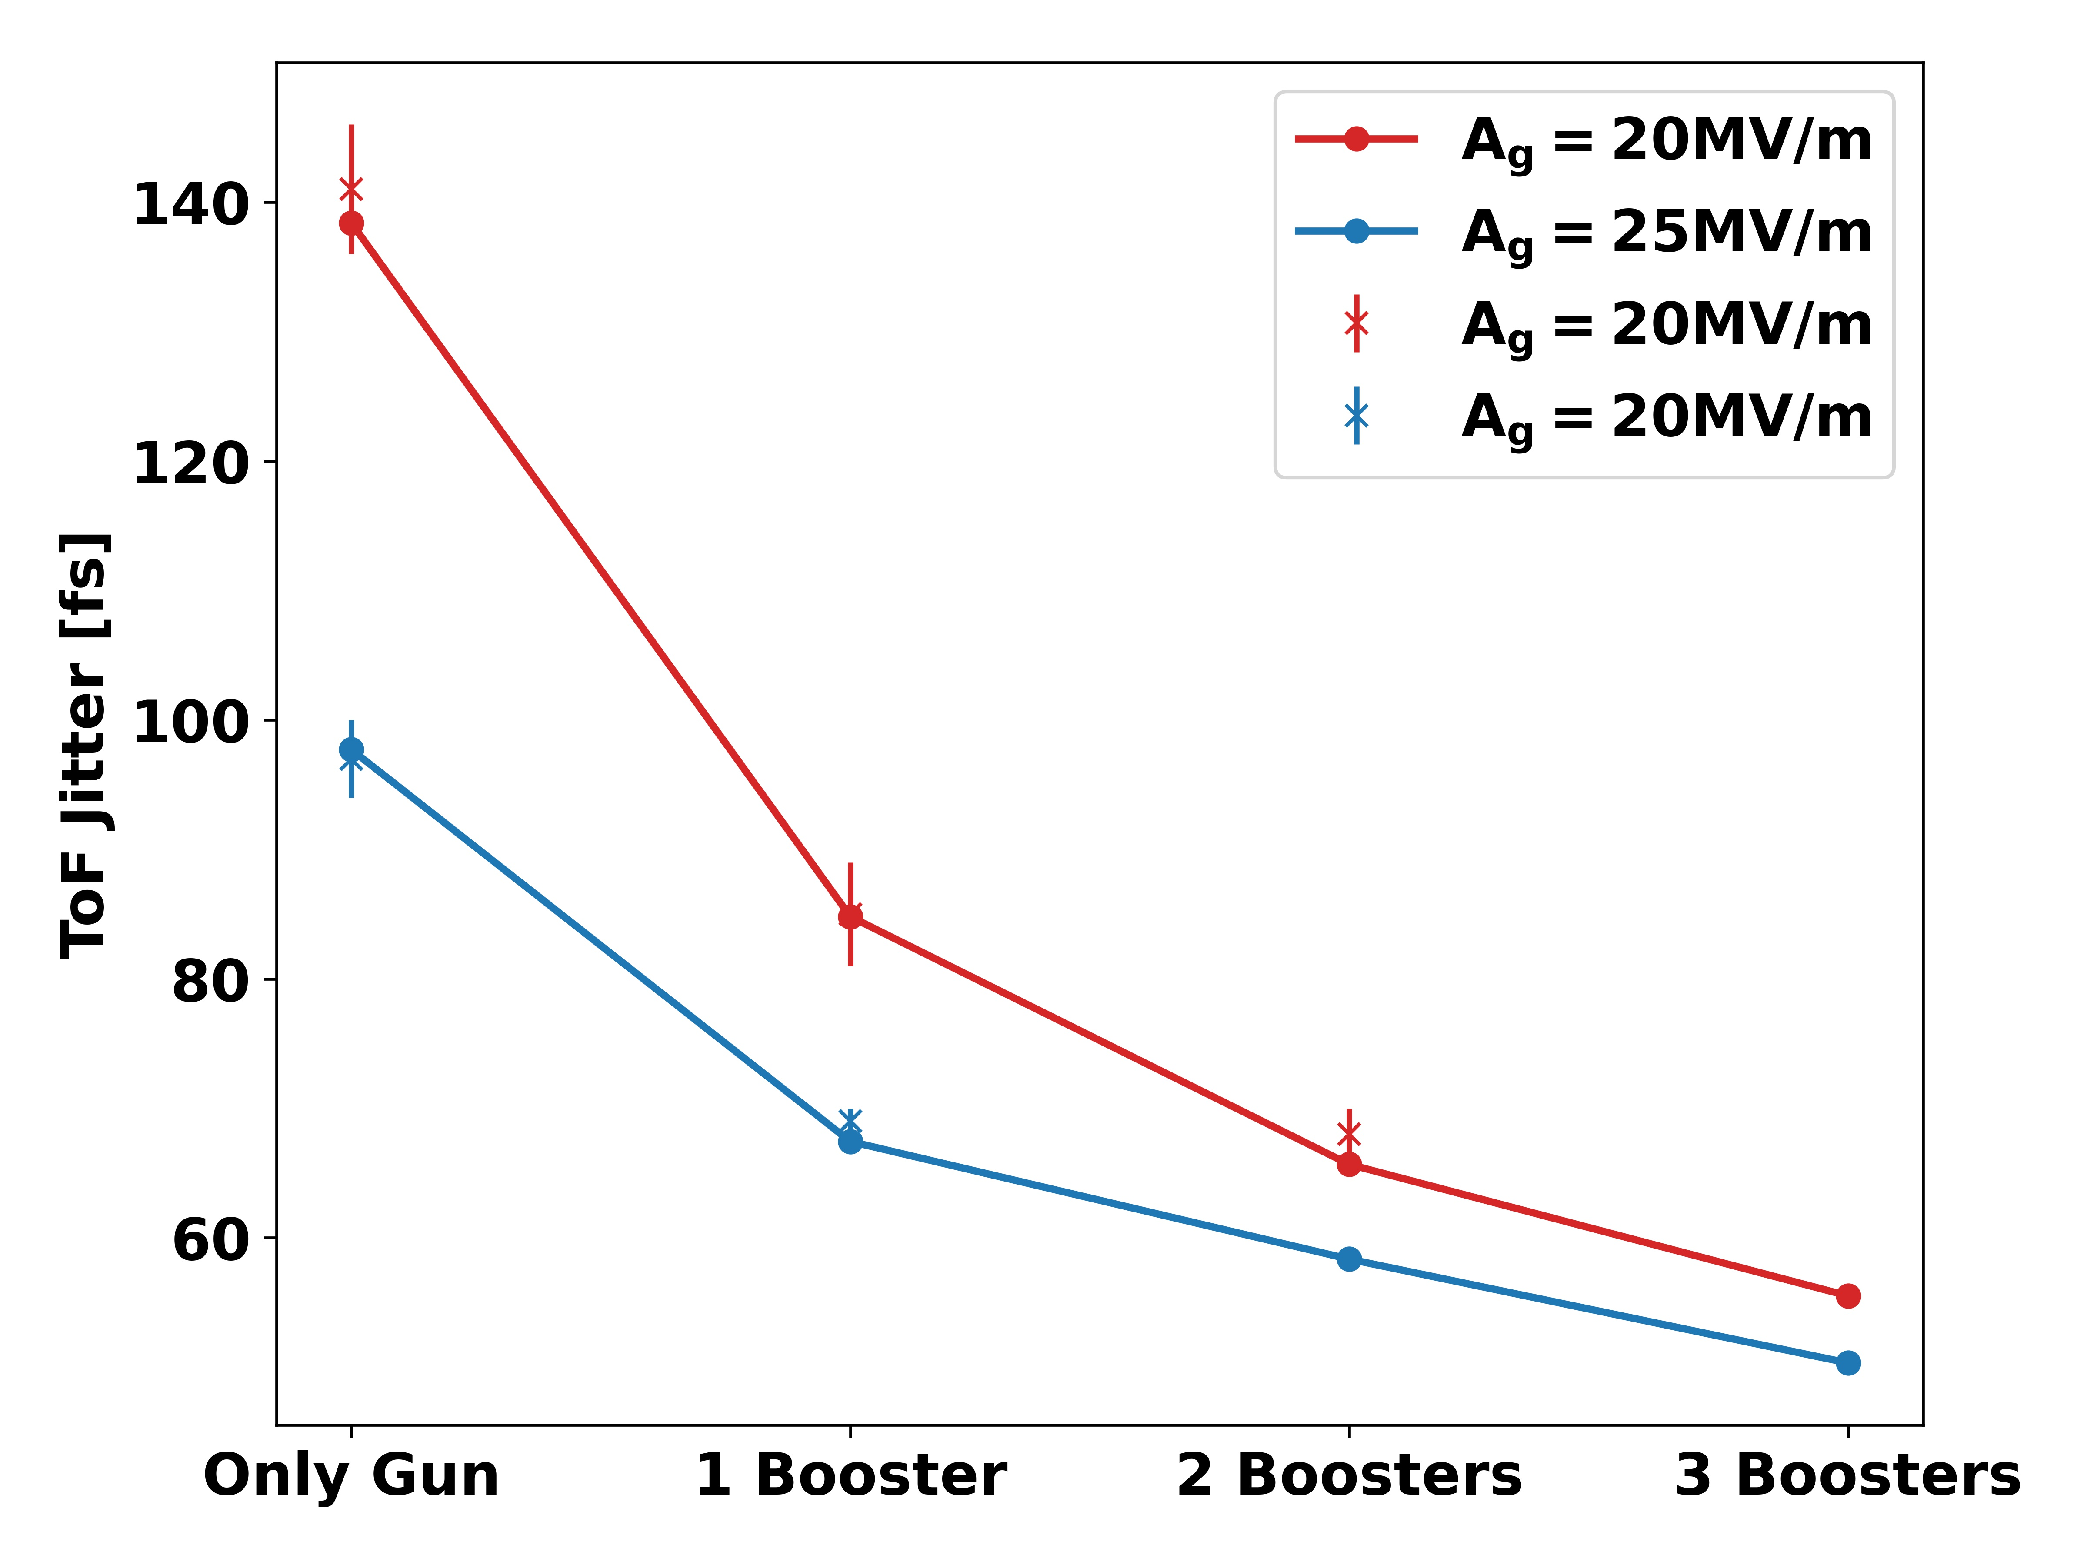
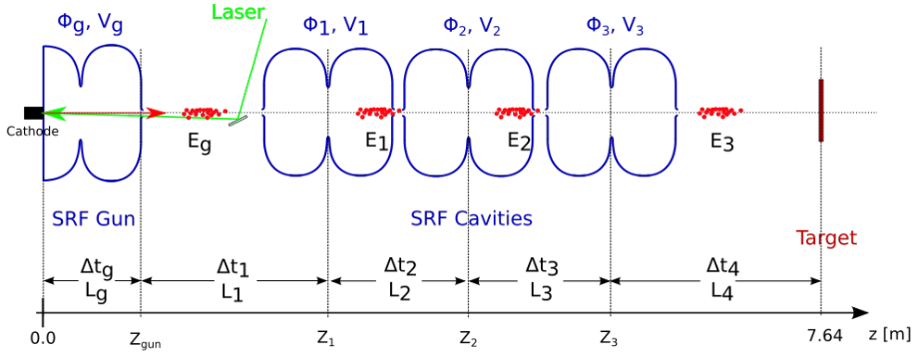
Time of flight jitter – correction

Slide 8
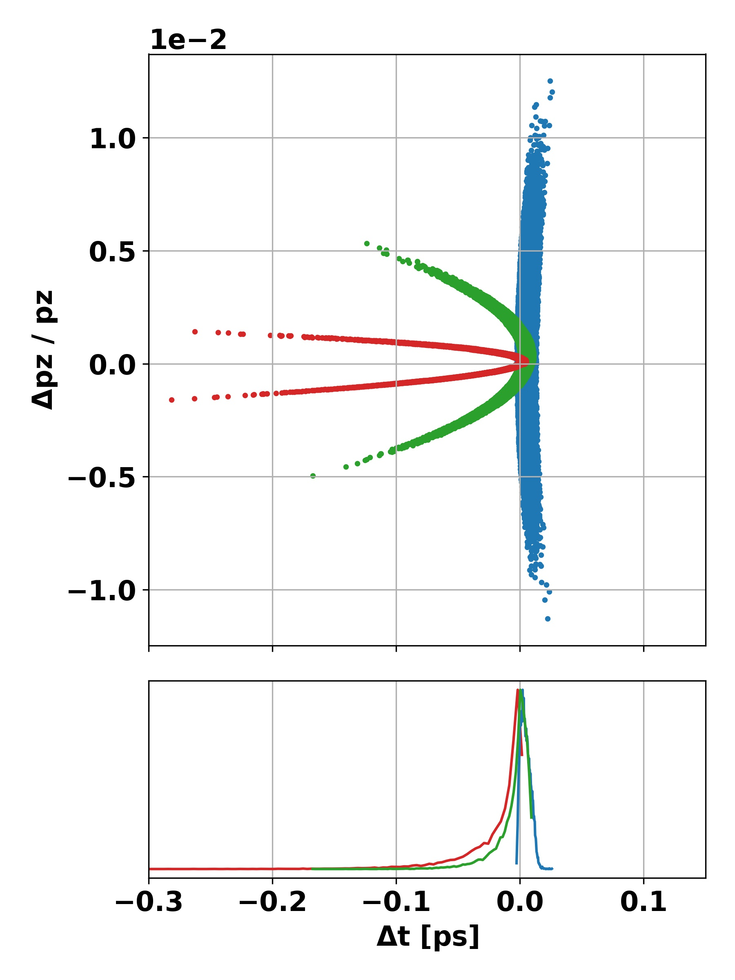
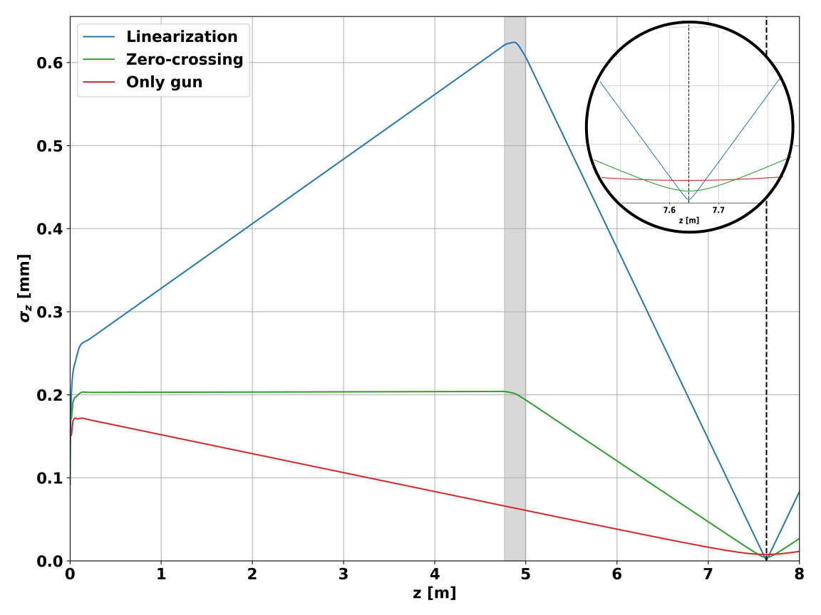
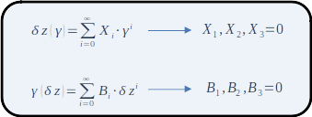
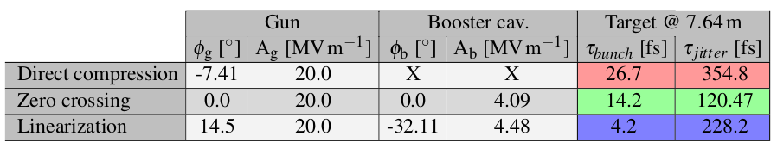
Bunch length – compression methods

Slide 9
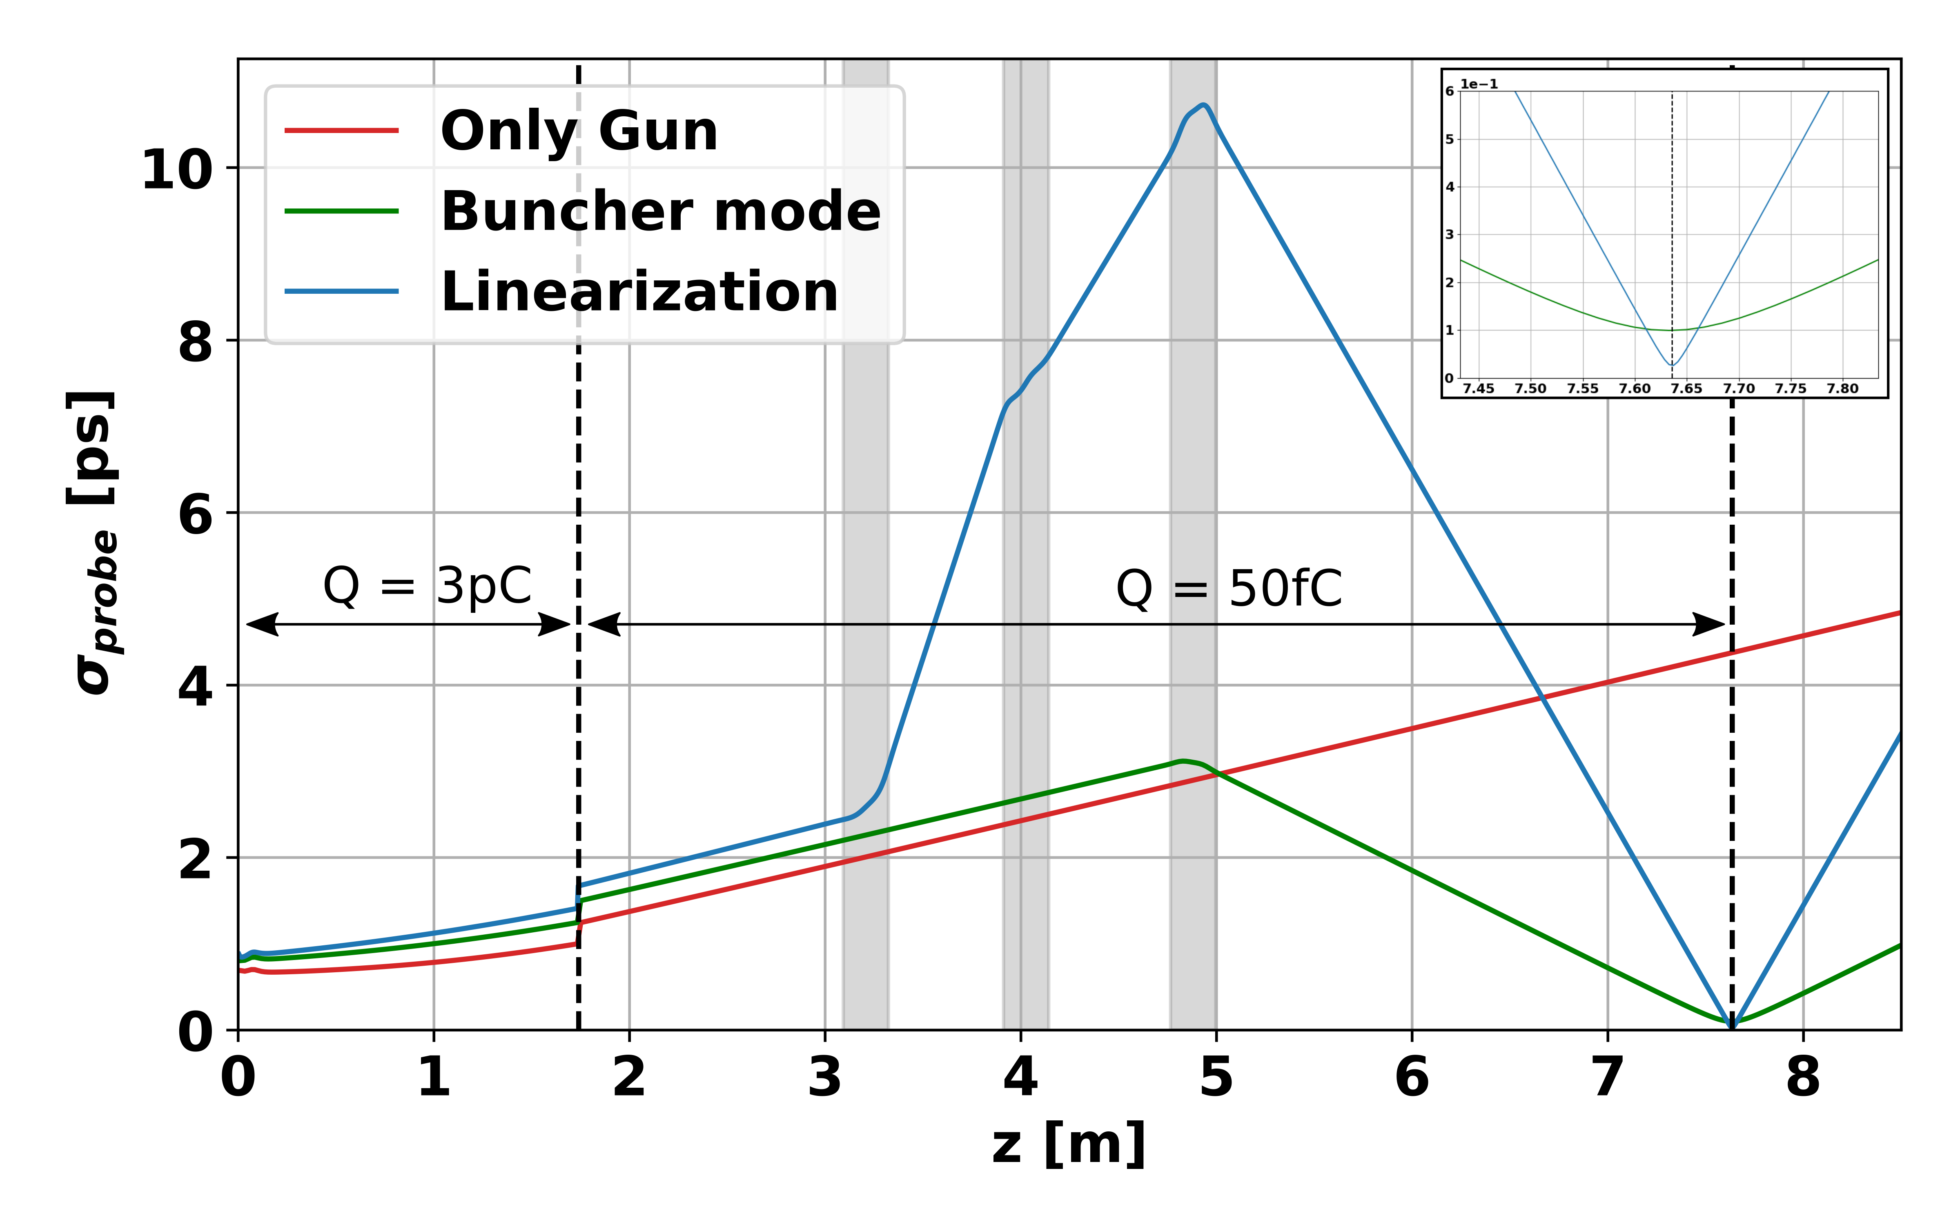
Bunch length – compression with sc

Slide 10
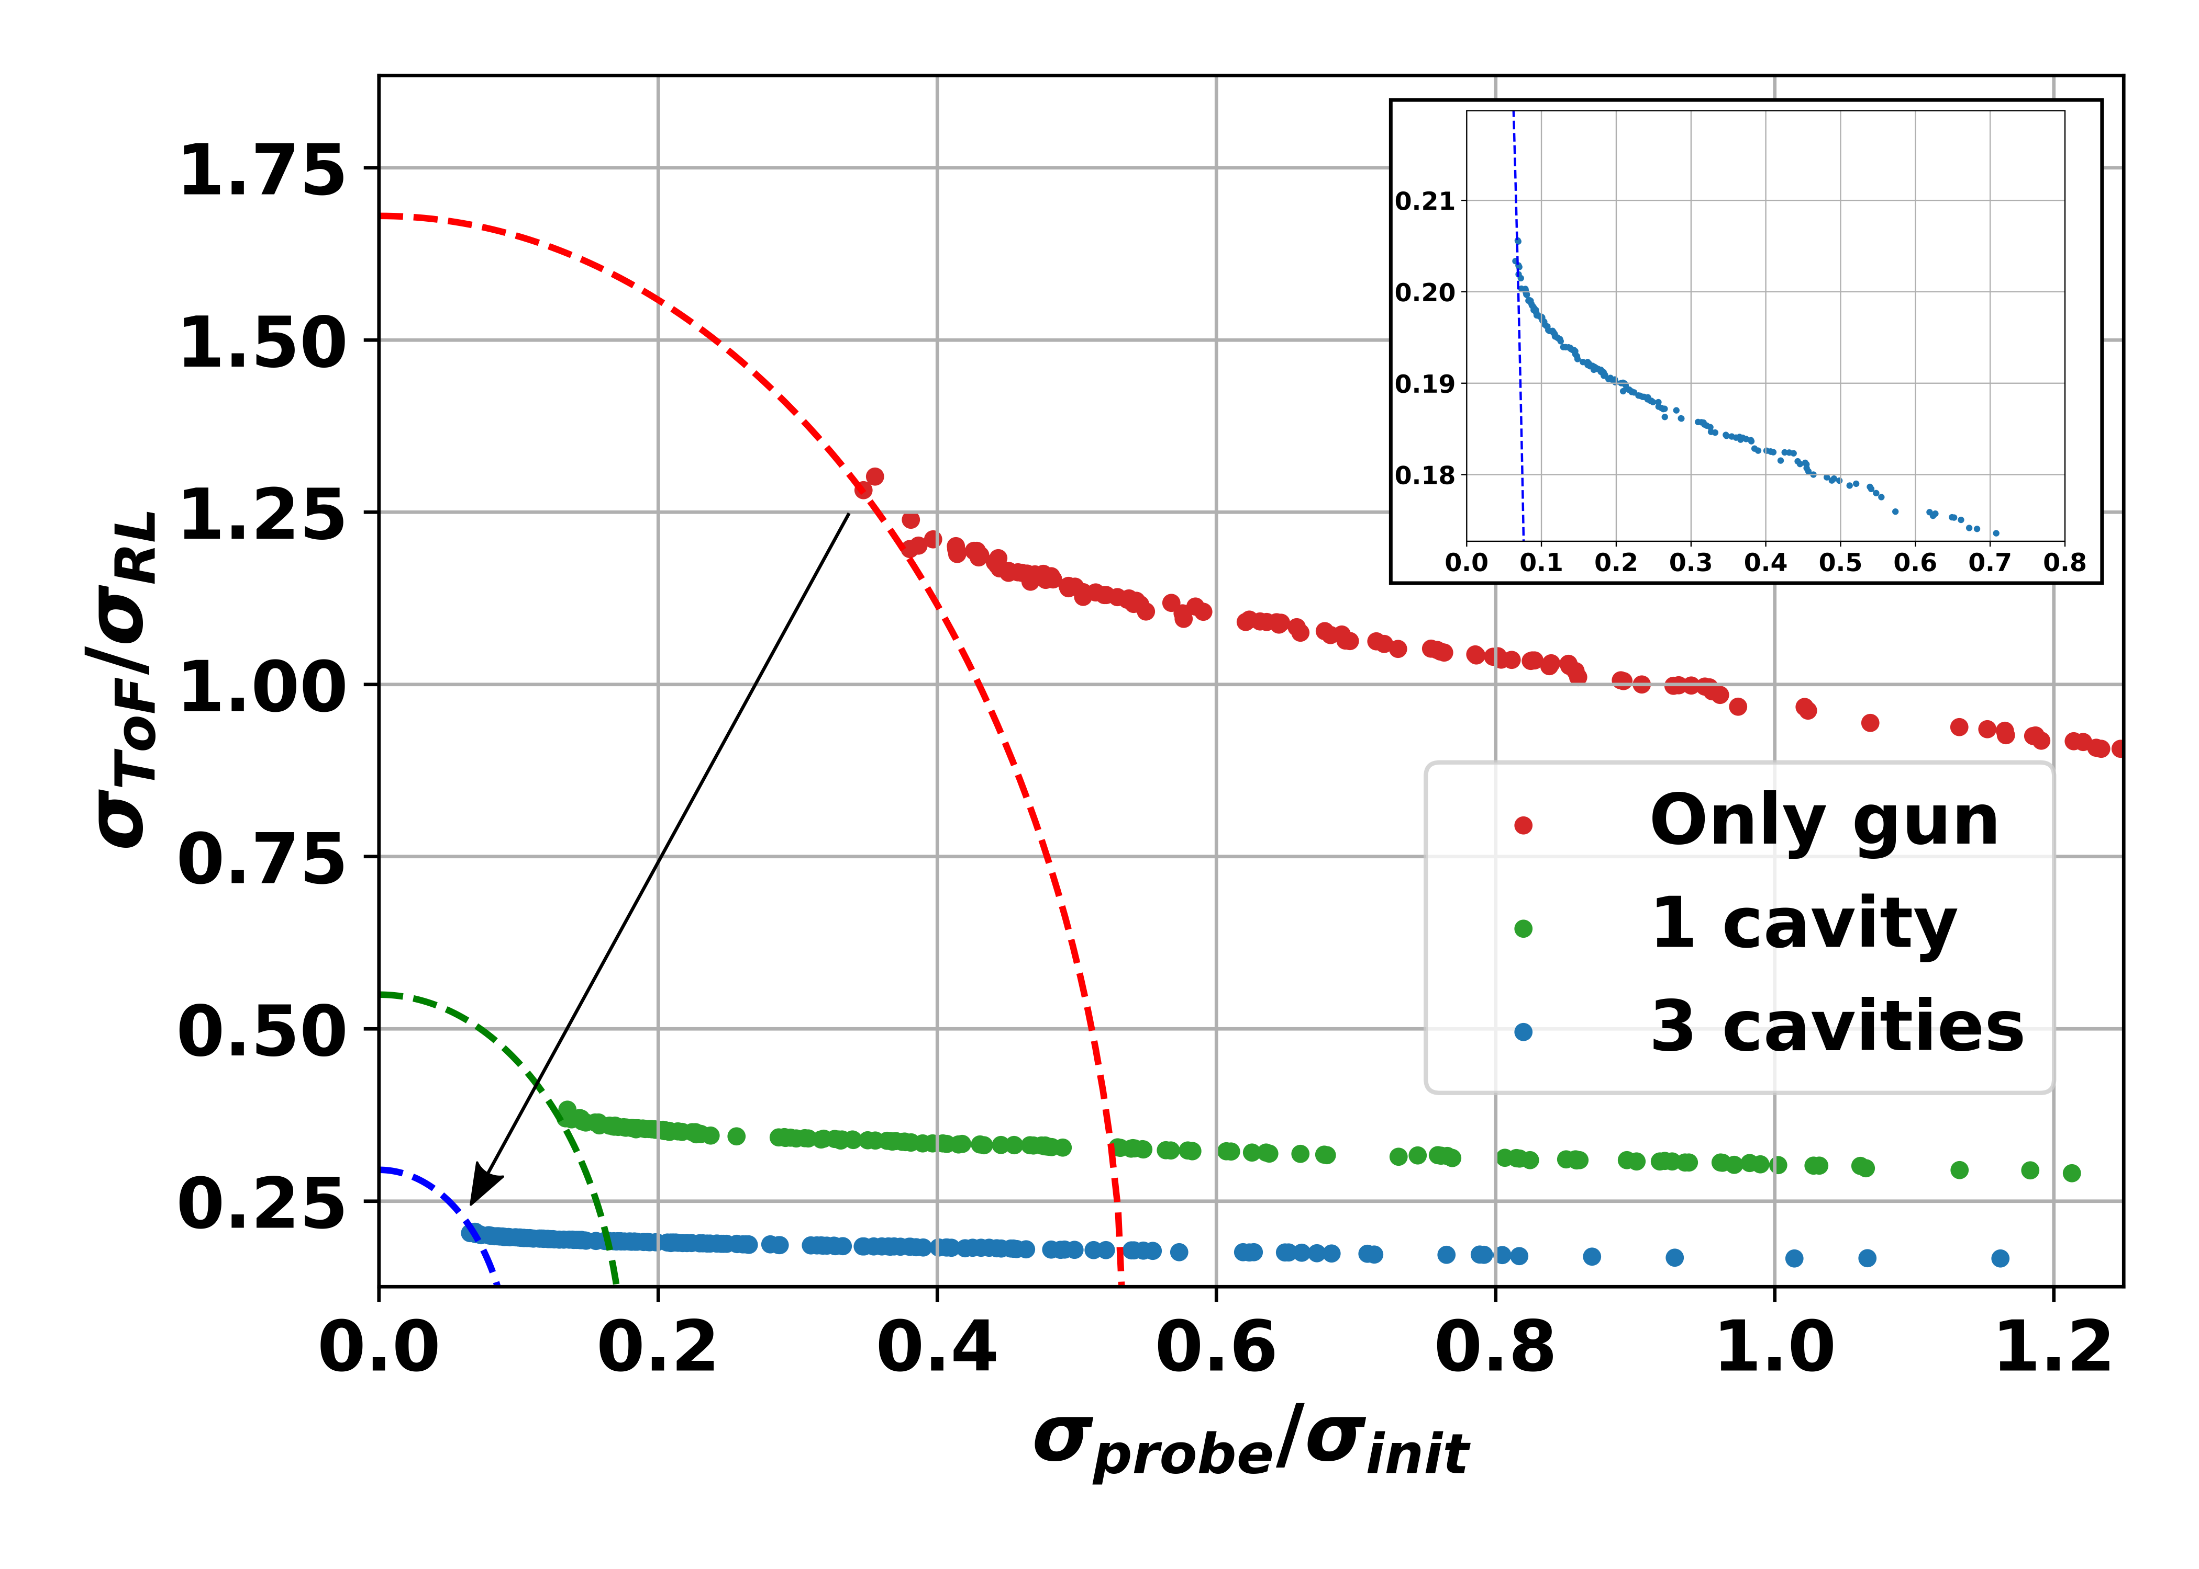

Slide 11
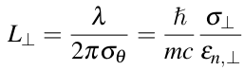
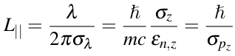
The transverse beam parameters are mainly dependent on the gun, gun solenoid and initial laser parameters.
How can one optimize the 'quality' of a static diffraction experiment?
How can we increase lateral and longitudinal coherence lengths?
Multi-parameter space optimization.
Identify which input parameter affects which output parameter.
Set priorities and targets for the outputs.
Perform the optimization step by step, first fixing the input
parameters that affect the highest priority output parameters.
Input parameters one can adjust:
Laser spot size
Laser pulse length
Gun amplitude and phase
Solenoid A and B strength
Initial bunch charge
Lateral coherence length
Longitudinal coherence length
Output parameters for static exp.:
Bunch charge (= 50 fC)
Trans. Emittance (as low as pos.)
Energy spread (as low as pos.)
Bunch spot size (around 300um)
Beam energy (2 to 3 MeV range)
Second Progress Report – Benat Alberdi

